Slide 1
Welcome to AIC’s
Online Community

Slide 2
Welcome!
Our online community is more than just a website.
It’s a professional networking and information tool designed to connect members, allied professionals, and staff of the American Institute for Conservation and its foundation.

Slide 3
This community:
provides instant access to field-wide discussions, organizational news, and current research
allows users to quickly and easily connect
provides a forum for accomplishing specialty group, committee, and governance work
allows users to engage in online discussions

Slide 4
In short, the community provides us with an unprecedented opportunity to reach new heights and ultimately to be of greater service to our members and the conservation field.
Let’s get started!

Slide 5
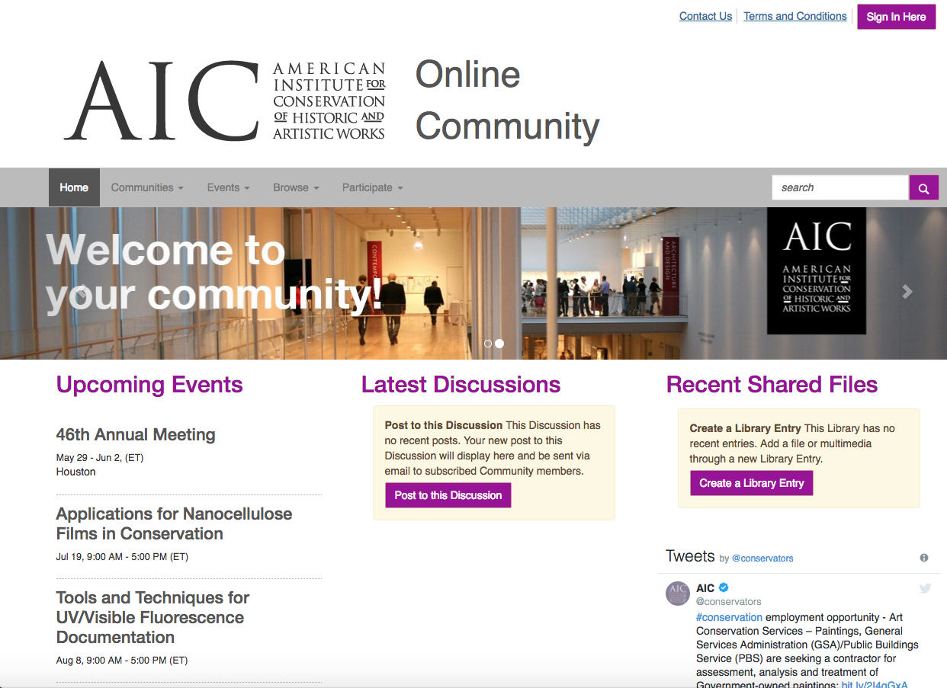
Step 1: Log in
Visit community.conservation-us.org .
Click on the “Sign In Here” button in the upper right corner. This will take you to AIC’s site; log in using your regular account information (email and password).
Having trouble? Click on the “Forgot Password?” link or email our membership team at membership@conservation-us.org.

Slide 6
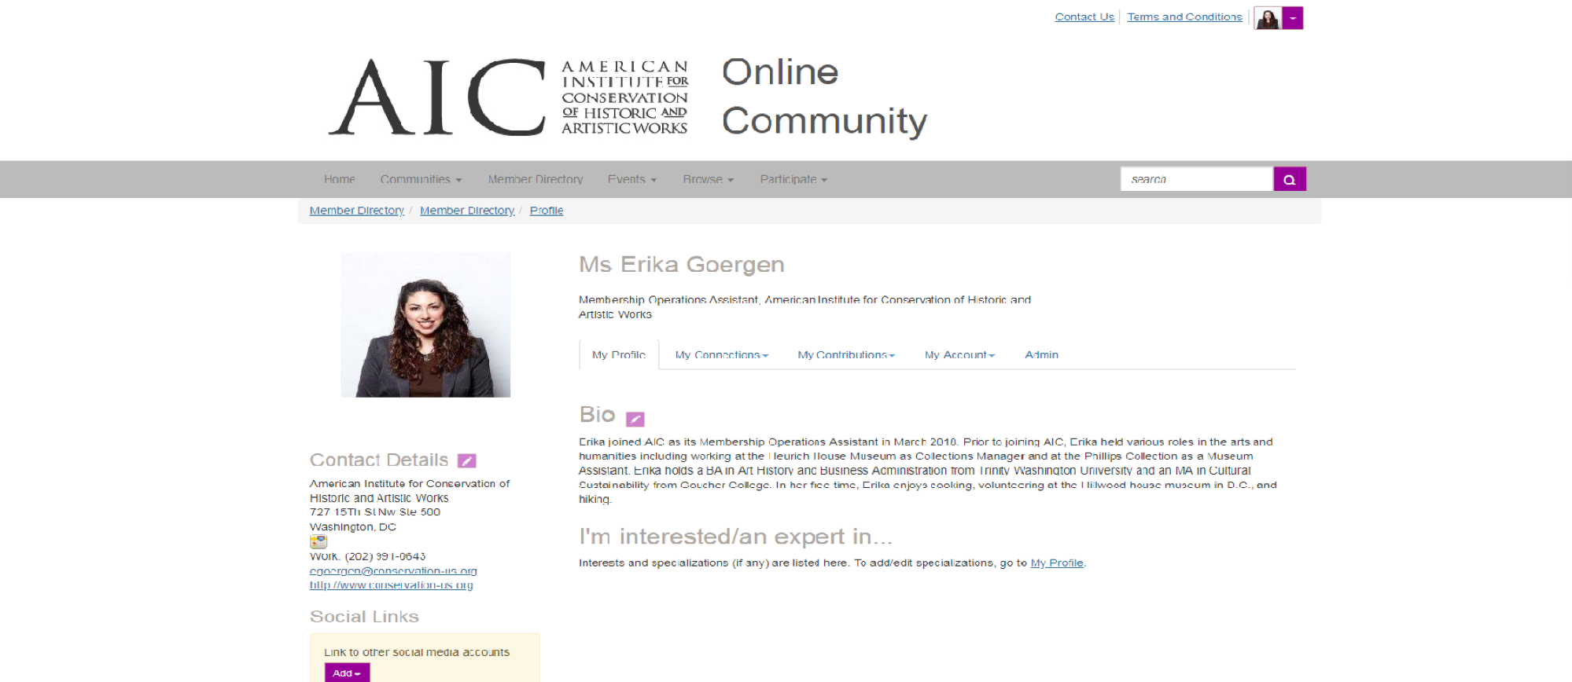
Step 2a: Complete Your Profile
Once you log in, click on the arrow next to your picture (top right of screen) and select “Profile”. Begin by double-checking your profile information.
You may see that a lot of your profile is already filled out! If any of the information is incorrect, such as your contact details, bio, or interests/specializations, click the pencil icon to the right of the area to edit the information. This will take you back to the AIC site so you don’t have to update your information twice!
Come back to the community by either following the link on your member dashboard or by navigating to community.conservation-us.org again.

Slide 7
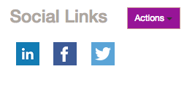
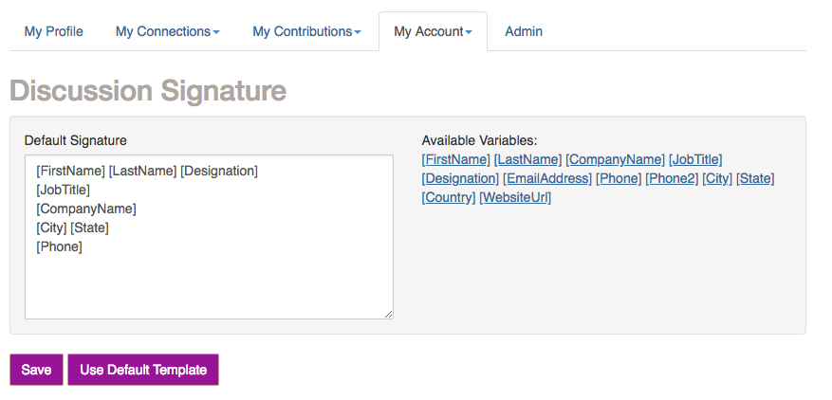
Step 2b: Complete Your Profile
If you have a LinkedIn account, you can use the “Update your Information from LinkedIn” link to complete your profile. (Note: this will only add your current positions)
Complete the Education and Job History sections by using the Add/Edit links (optional).
While on your profile page, click “My Account” and then select “Discussion Signature.” You can add variables that automatically pull from your AIC profile, so it updates when you make any change, or you can create your own custom signature that will be added to your posts.

Slide 8
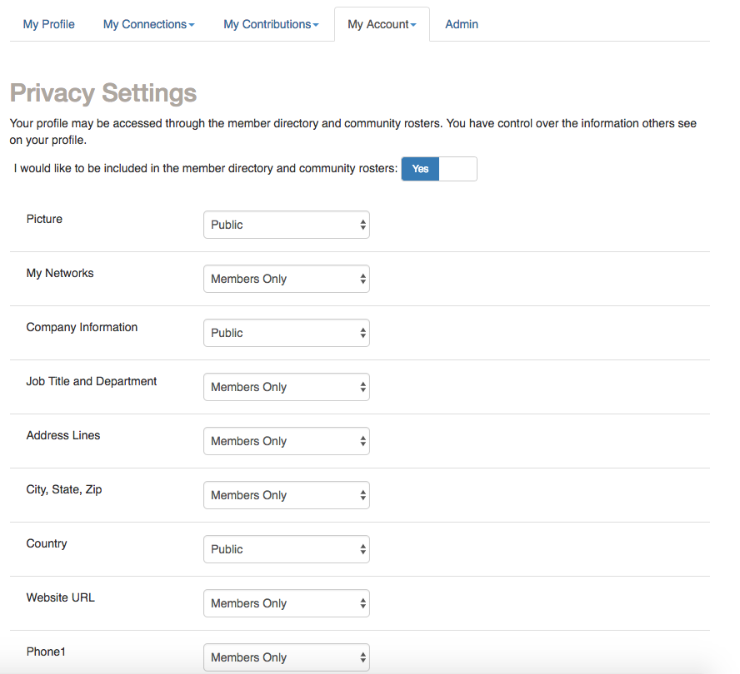
Step 3: Customize Your Privacy Settings
In your profile, click “My Account” and select “Privacy Settings.” Here, set your contact preferences and control how much of your information appears to others.
After setting your preferences, click “Save Changes.”

Slide 9
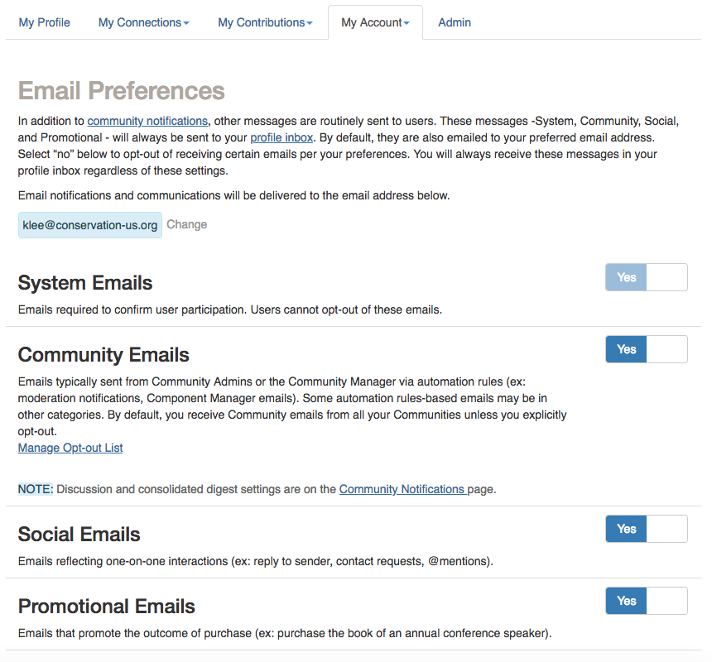
Step 4a: Customize Your Subscriptions
In your profile, click “My Account” and then select “Email Preferences.”
You can choose whether or not you receive emails from community managers, social emails like requests to add contacts and mentions, and promotional materials.
We recommend you leave them on, but we wanted to make sure you knew where to access these settings.

Slide 10
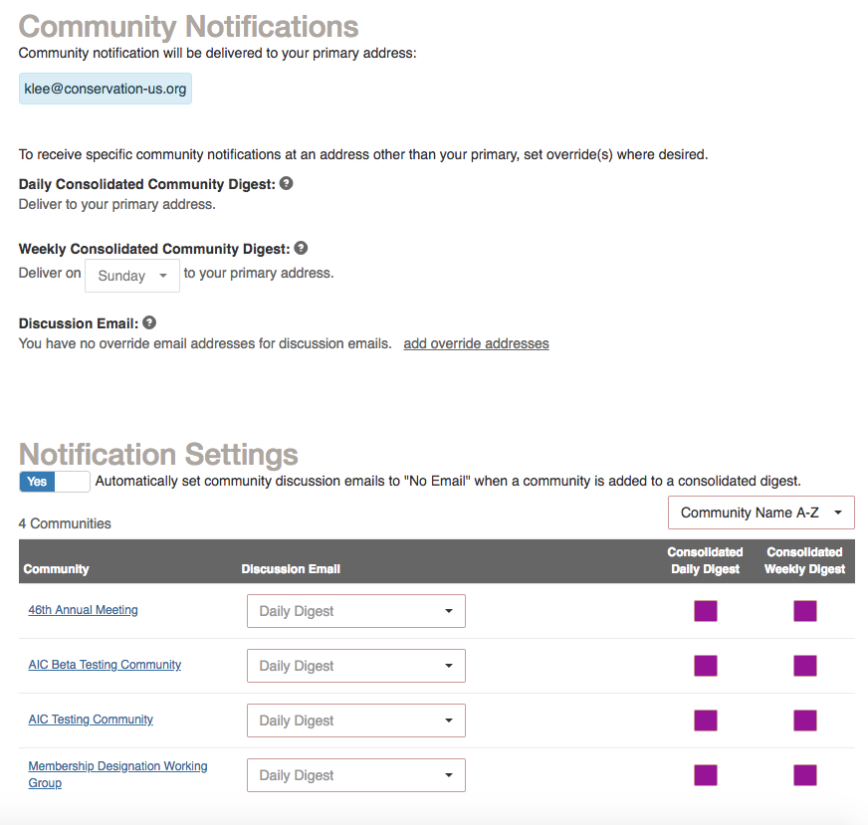
Step 4b: Customize Your Subscriptions
While you are in “My Account,” go to “Community Notifications.” Here, you will set your notification preferences for discussions and other activity in your communities. You can choose to be notified in Real Time, by Daily Digest, by Consolidated Weekly Digest, or you can choose to receive No Email notification at all. Setting your subscriptions to No Email requires logging in to the community to view all activity.
We recommend the Daily Digest; you get fewer emails, but still get timely updates!
If you become a member of multiple communities, you can consolidate updates from all your communities into one digest! Each community has a check box for “Consolidated Daily Digest” and a drop-down menu with options under “Discussion Email.” For any communities you’d like to consolidate into one digest, use the drop-down menu to select “No Email” and instead check the ”Consolidated Daily Digest” box.
Note that one-click email links to your community are disabled in Consolidated Digests, as they contain more than one community!

Slide 11
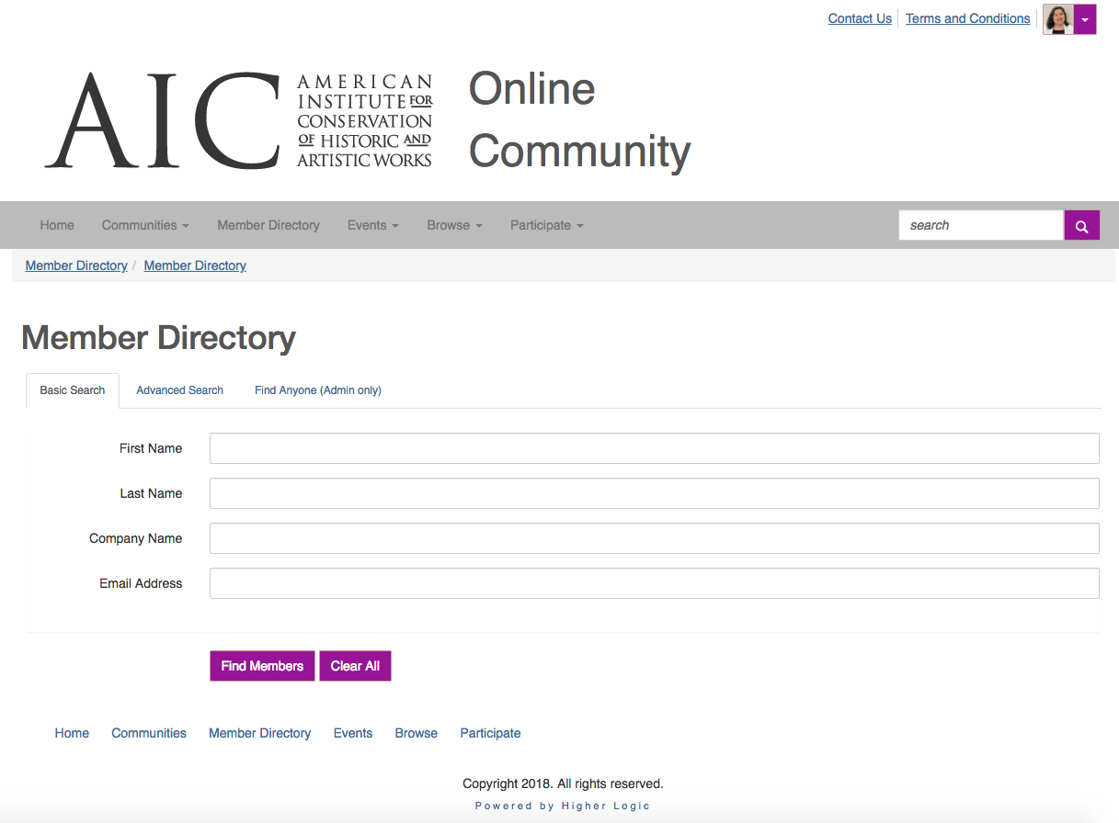
Step 5: Find Members
Using the gray navigation bar, select “Member Directory.” You can search for all members and users with this tool.
You have two search options. “Basic Search” allows you to search by First Name, Last Name, Company Name, or Email Address. “Advanced Search” also allows you to search by Location, Community Type, Community Name, and Expert Demographics.

Slide 12
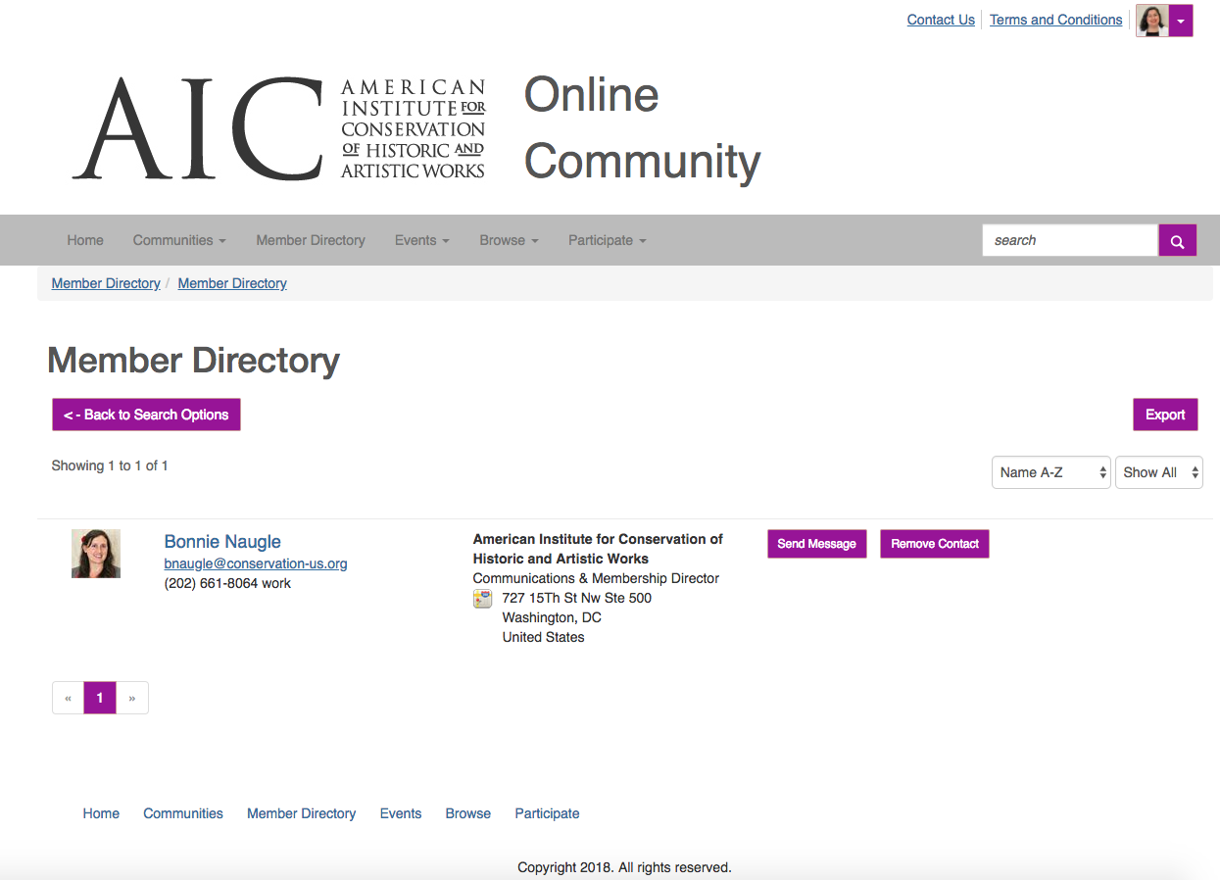
Step 6: Invite Contacts
Now you’re ready to build your contact list. Go to the Member Directory and search for your colleagues.
In list view, you will see the member’s name, their contact information, and two buttons, “Send Message” and “Add as Contact.”
If you click “Add as Contact,” a pop-up message will appear asking if you’d like to invite that person to become a contact, so if you’ve clicked in error, you can still cancel. If you do want to add them, click “Send.” If you’ve already added them, it will say “Remove Contact.”
If you land on an individual’s profile page while browsing, you will see the “Add as Contact” button to the right of their profile picture.

Slide 13
Step 7: Explore!
Now that you’ve logged in, built up your profile, set your preferences, and invited new contacts, you’re able to explore and discover all that the community has to offer.
Send messages. Read blogs. Catch up on late-breaking news. Join a discussion. It’s all here in one place!

Slide 14
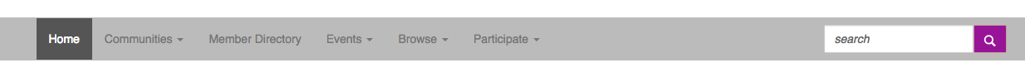
Navigation
Communities: See a list of communities you’re a part of or explore “All Communities” to see where else you can join the conversation!
Member Directory: Find other AIC members and expand your professional network!
Events: Find out more about upcoming programs!
Browse: Just looking around? You can browse Discussion Posts and Library Entries if you’re looking for new reading material!
Participate: Still a little stuck? Check out the Help/FAQs section! Want to get started posting discussion threads or a resource? Use “Post a Message” or “Share a File!”

Slide 15
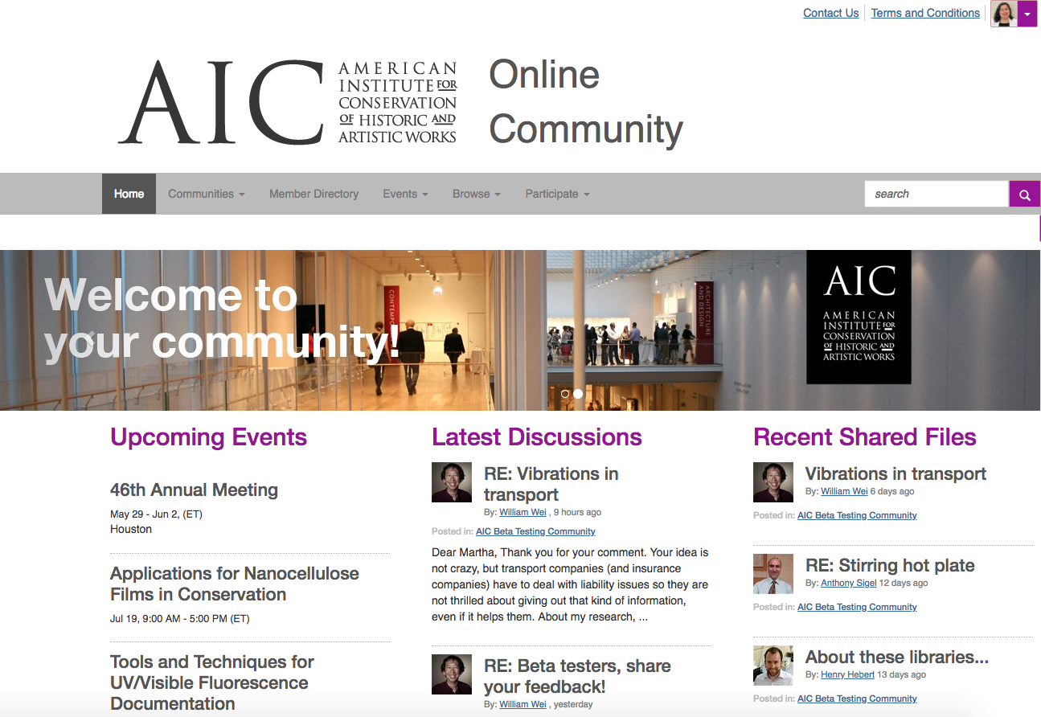
Community Home: Your Home Base!
Upcoming Events: A calendar of upcoming AIC events is on the left side of the page! This will include meetings, workshops, and important deadlines, like our elections.
Latest Discussions: See what’s going on in the communities you’re a part of! Recent conversations will load in this area in the center of the page, keeping you up-to-date on what your colleagues are talking about.
Recent Shared Files: The community will be a great way to share resources and provide access to publications and materials. See what’s new here on the right side of the page!
Tweets: See the latest from AIC’s twitter account, @conservators, here! This section is below “Recent Shared Files.”
Most Active Members: Who’s leading the conversation? Take a look at some of our most active members in this section at the bottom of the page! Keep posting and you might see yourself featured here!

Slide 16
Glossary of Terms
Here are some terms and definitions you may find helpful as you navigate your way through the community:
community – a group of people organized around a common subject, interest, or theme. Communities are also organized around the different committees, working groups, networks, specialty groups, and leadership positions. This enables users to easily participate in only the communities they are a member of and in those which interest them.
discussion – sometimes referred to as “forums,” these are topics or questions that are interactively grouped within—and related to—a specific community. All comments responding to the topic are posted beneath the initial topic and become a discussion thread. A “thread” is generally defined as a single topic under discussion by a group.
posting – a message or file submitted to a community for which you are a member.
ribbons – these appear under a member’s profile picture and serve as indicators of how active the member is within the community. They may also describe the activities or professional designations the member has within AIC.

